Slide 1









About Argelo Royce Bautista
B.S. Computer Engineering Graduate
8 years of industry experience
Senior Business Intelligence Analyst @ Analog Devices Inc.
Web Development (jQuery, Angular, etc) [2 years]
Mainly Deals w/ Business Intelligence (Microsoft Excel and PowerBI) [9 years]
Core Member of technical communities:
Philippine Data Platform User Group (formerly PHISSUG)
Programmers Codeposting (formerly Programmers, Developers)

Slide 2

https://www.facebook.com/groups/ProgrammersCodepostingPH/
Notes:
Community of Programmers and any enthusiast of the SDLC

Slide 3

https://www.facebook.com/groups/PDPForums
Notes:
Community of Database professionals.

Slide 4
Power BI and the Philippine Standard Geographical Code
Argelo Royce Bautista

Slide 5
Agenda
Data Analysis concepts
Why use Power BI?
Industry Leader (Forrester Wave & Gartner Magic Quadrant)
Easy to Learn & practice (balance between visual tool and coding tool)
Wide selection of data sources (use one language to analyze multiple sources)
Philippine Statistics Authority & the Philippine Standard Geographical Code
Role of PSA as a Data Steward
Administrative vs Geographical
Transforming the Data to a hierarchy
Adding columns (Region, Province, City, Barangay,
Using the UI
Custom Formula
Columns by Example
Publishing to Web
Reusing the published data

Slide 6
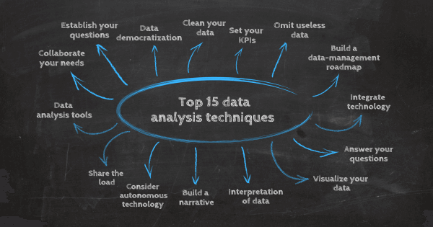

Slide 7
Why use Power BI?

Slide 8
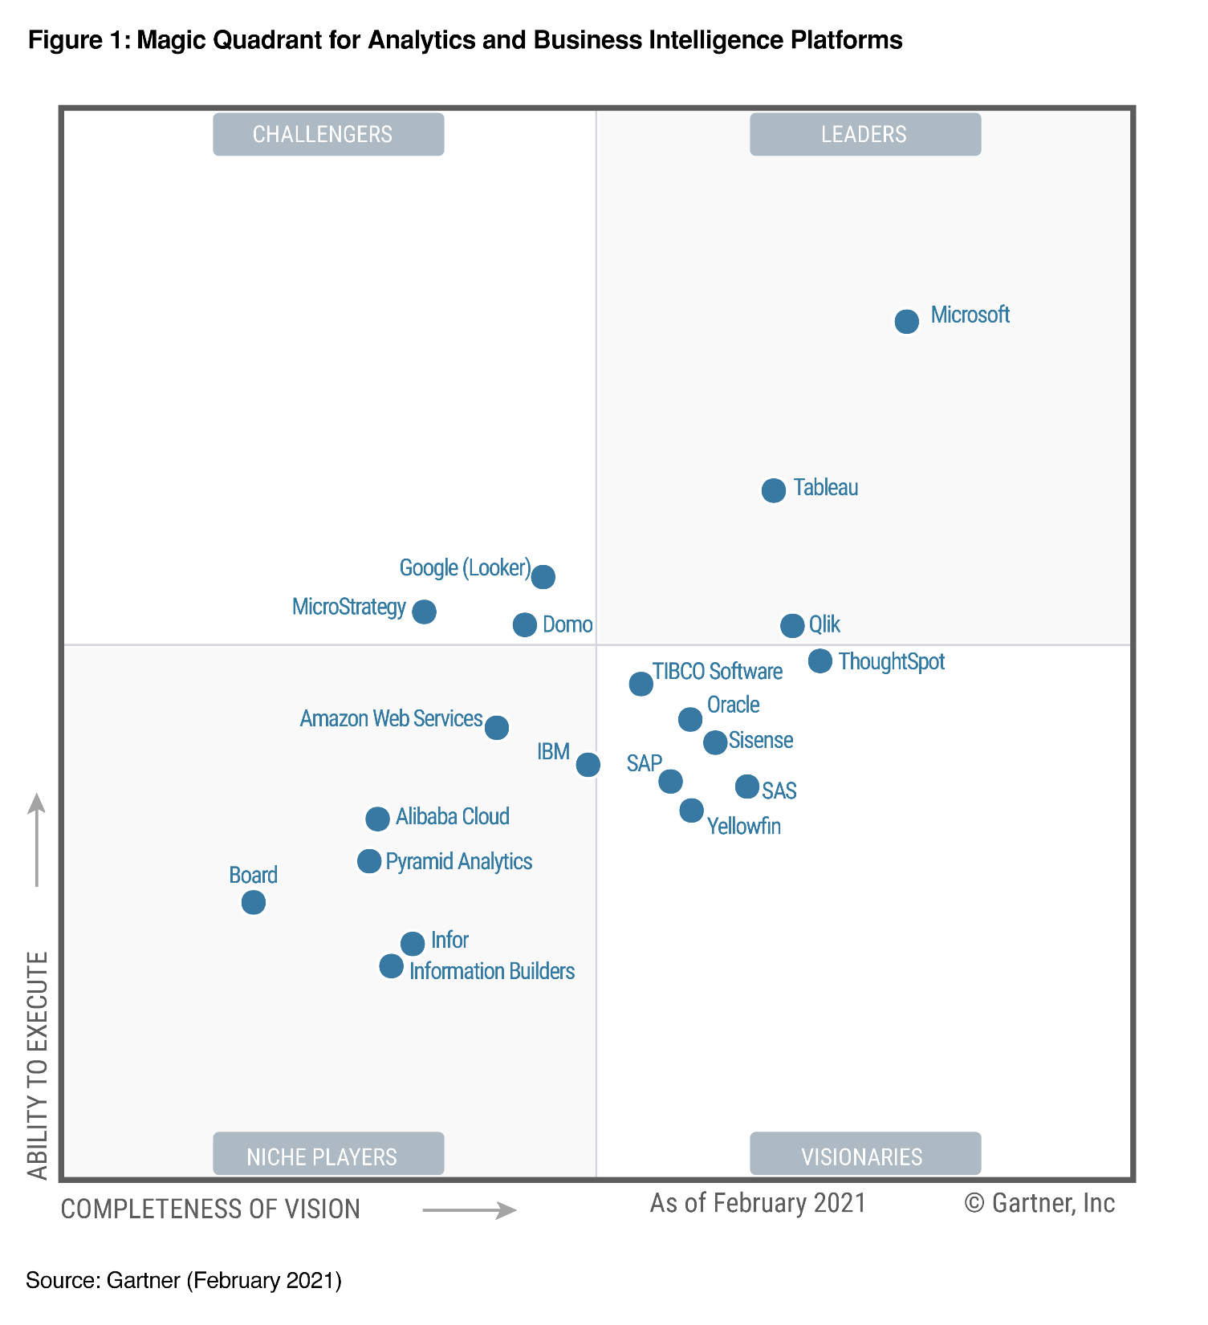
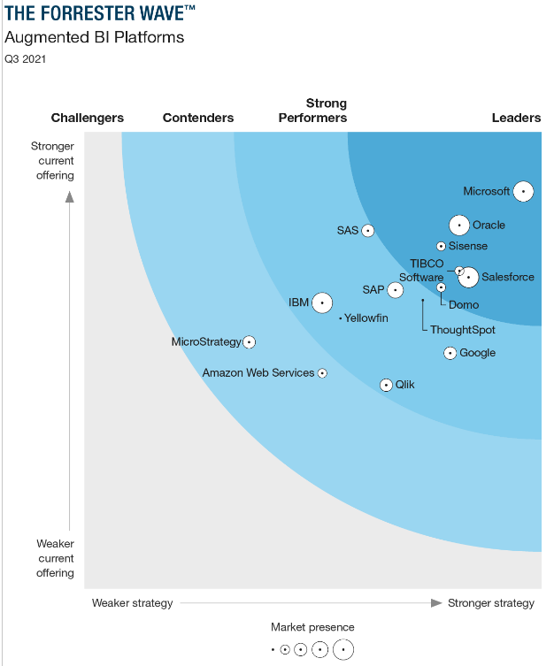
Notes:
Gartner Magic Quadrant: Analytics and business intelligence (ABI) platforms are characterized by easy-to-use functionality that supports a full analytic workflow — from data preparation to visual exploration and insight generation — with an emphasis on self-service usage and augmented user assistance. Forrester Wave Q3 2021 for Augmented BI: empowering users to become citizen data scientists drawing on the power of ML and broadening the reach of data and analytics to all decision-makers via conversational UIs.
“…consider Power BI as your top choice for an enterprise BI platform, especially if your organization plans to deploy most of its business and productivity applications and store and process most of the data on Microsoft Azure.”

Slide 9
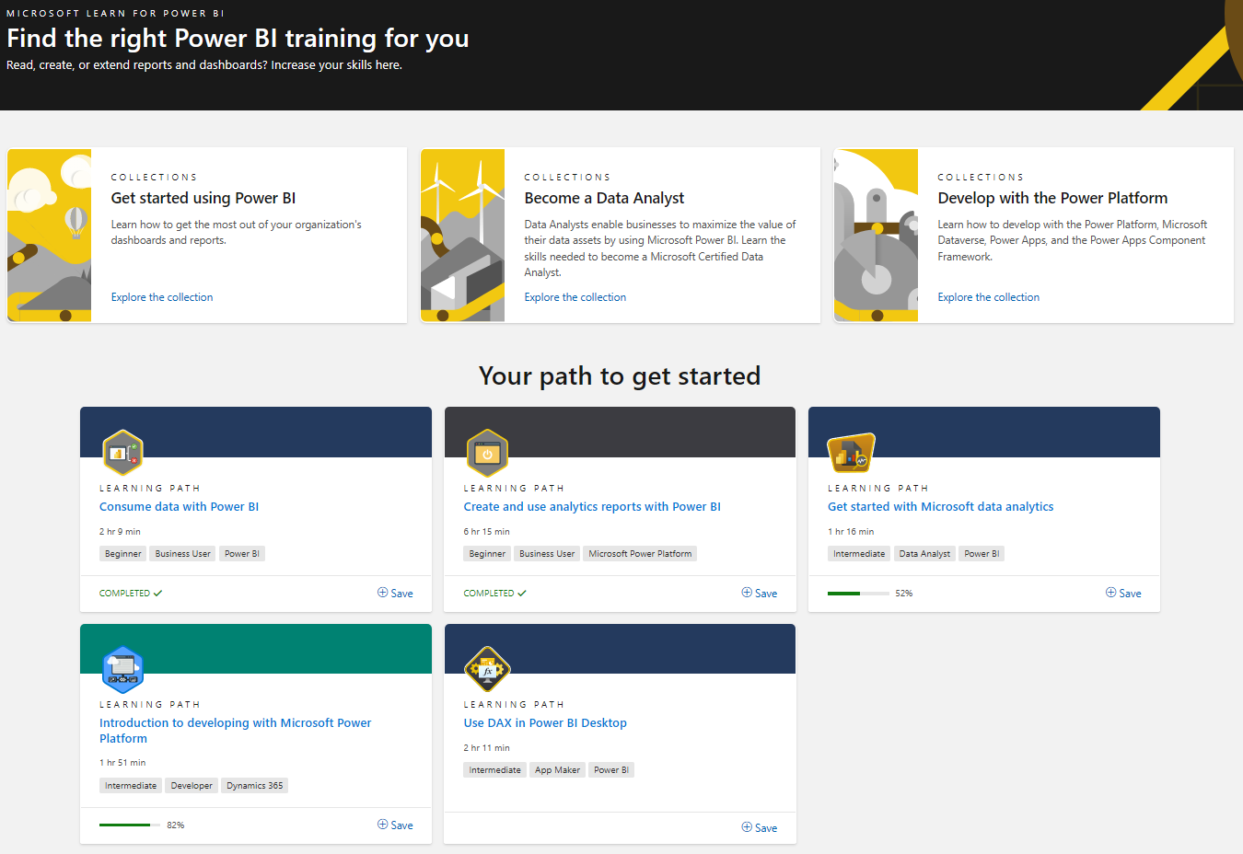
Learning Materials @ https://docs.microsoft.com/en-us/learn/powerplatform/power-bi
Notes:
https://docs.microsoft.com/en-us/learn/powerplatform/power-bi Lab Example: Lab - Introduction to DAX in Power BI Desktop - Learn | Microsoft Docs

Slide 10
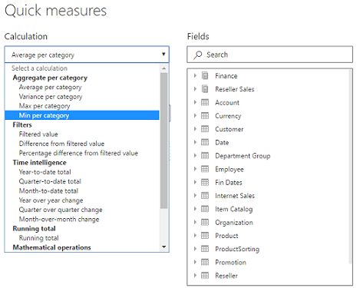
Learning the Formula Language (DAX)

Slide 11
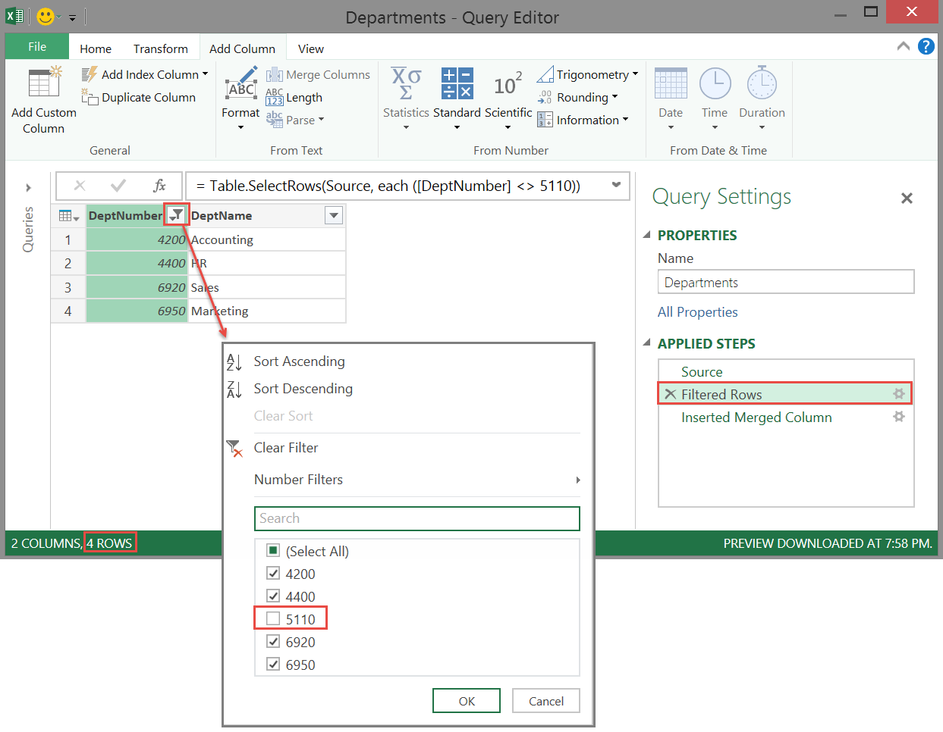
Learning the Data Transformation Language

Slide 12
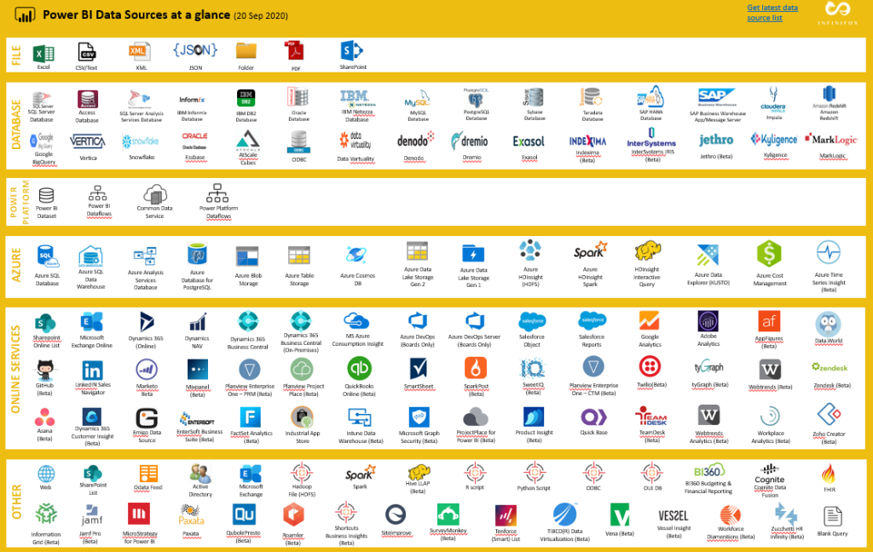
Wide Selection of Data Sources

Slide 13
Demo Data: Philippine Statistics Authority’s Philippine Standard Geographical Code

Slide 14
Philippine Statistics Authority (PSA): Mandates
The PSA shall primarily be responsible for the implementation of the objectives and provisions of R.A. 10625, R.A. 11055, and R.A. 11315.
It shall plan, develop, prescribe, disseminate, and enforce policies, rules and regulations, and coordinate government-wide programs governing the production of official statistics, general purpose statistics, civil registration services and inclusive identification system.
It shall primarily be responsible for all national censuses and surveys, sectoral statistics, community-based statistics, consolidation of selected administrative recording systems, and compilation of national accounts.
Ref: About PSA | Philippine Statistics Authority
Notes:
PSA is effectively functioning as a Data Steward

Slide 15

Data Steward
Ensure Data Integrity
Ensure and improve Data Provenance and Traceability
Improve Data Quality metadata
Ensure and improve archiving requirements

Slide 16
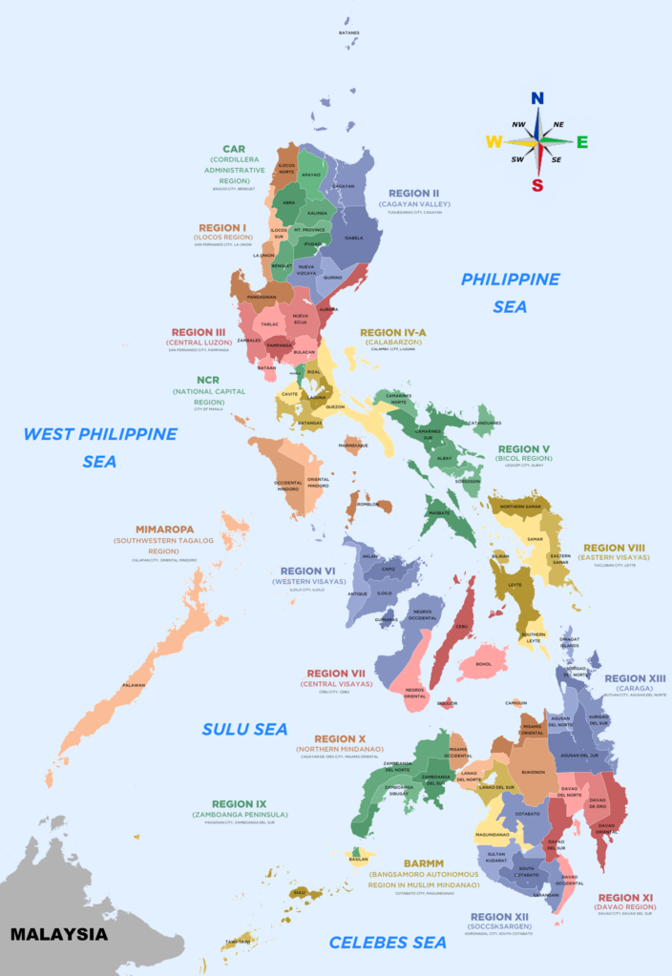
Philippine Standard Geographical Code
The Philippine Standard Geographic Code (PSGC) is a systematic classification and coding of geographic areas of the Philippines.
It is based on the four well-established hierarchical levels of geographical-political subdivisions of the country such as the administrative region, the province, the municipality/city and the barangay.

Slide 17
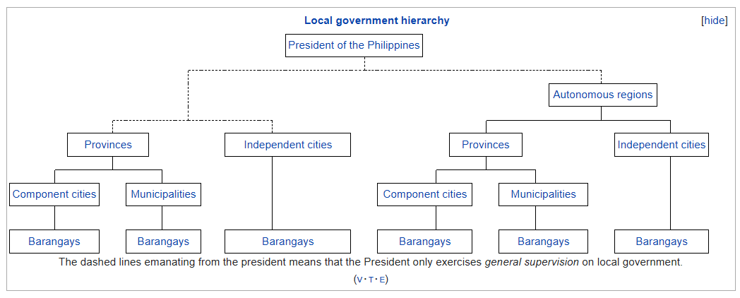
Administrative vs Geographical

Slide 18
Q & A

Slide 19


https://forms.office.com/r/0CXhLku8jC
Thank you for listening! Contact me @: roycebautista@prodevs.org

Slide 20
References
What Is Data Analysis? Methods, Techniques, Types & How-To (datapine.com)
Microsoft named a Leader in The Forrester Wave™: Augmented BI Platforms, Q3 2021 | Microsoft Power BI Blog | Microsoft Power BI
Microsoft named a Leader in the 2021 Gartner Magic Quadrant for Analytics and BI Platforms | Microsoft Power BI Blog | Microsoft Power BI
Power BI on Microsoft Learn | Microsoft Docs
https://docs.microsoft.com/en-us/users/roycebautista/collections/0np0i8467kgo1n
Quick measures - Microsoft Power BI Cookbook [Book] (oreilly.com)
Filtering in Power Query — SQL Chick
Power BI Data Sources at a glance – Data Analytics and BI Blog (amitzaveri.com)
As
Scientific Stewardship in the Open Data and Big Data Era — Roles and Responsibilities of Stewards and Other Major Product Stakeholders (dlib.org)

Slide 21


